Slide 1
Pumping Lemma in Theory of Computation

Slide 2
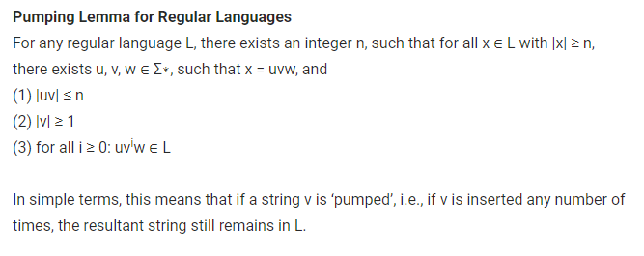

Slide 3
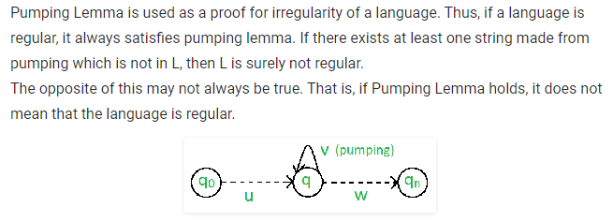

Slide 4
